Slide 1



Topological Data Analysis for Parkinson’s Disease Classification and Severity Assessment
Afra Nawar, Farhan Rahman, Narayanan Krishnamurthi, Anirudh Som, Pavan Turaga

Slide 2
Parkinson’s Disease
Statistics
Symptoms
2nd most common neurodegenerative disease
Incidence increasing
1 mil. affected in U.S., 10 mil. worldwide
Elderly most commonly affected
Muscle rigidity
Lack of balance and postural control
Tremors
Lack of fine motor skills
Notes:
To get a better sense of the motivations behind our research, the audience may wish to be familiar with some of the symptoms and statistics of Parkinson’s disease. This information helps to clarify why we focus on this problem and which methods we use to search for a solution.
Parkinson’s is the 2nd most common neurodegenerative disease, only following Alzheimer’s. There is about 1 million people in the US and 10 million people worldwide are affected by the disease and this is not a static number the incidence is only increasing. Additionally, the most commonly affected population is the elderly.
The most commonly seen symptoms of those affected by Parkinson’s are muscle rigidity, and tremors, as well as a lack of balance, postural control and fine motor skills. This may make it difficult for Parkinson’s disease patients to perform tasks that rely on intricate actions even if they are basic tasks such as drawing shapes.

Slide 3
Parkinson’s Disease
UPDRS
Proposed Method
Unified Parkinson’s Disease Rating Scale
Includes sections based on clinical motor evaluation, self evaluation, and Mentation/Behavior/Mood
Signal Processing paired with Machine Learning (Automated Assessment Tool)
Increased Objectivity
Increased Accuracy & Early Detection
Notes:
Make wih our aproach
Parkinson’s is the 2nd most common neurodegenerative disease, only following Alzheimer’s. There is about 1 million people in the US and 10 million people worldwide are affected by the disease and this is not a static number the incidence is only increasing. Additionally, the most commonly affected population is the elderly.
The most commonly seen symptoms of those affected by Parkinson’s are muscle rigidity, and tremors, as well as a lack of balance, postural control and fine motor skills. This may make it difficult for Parkinson’s disease patients to perform tasks that rely on intricate actions even if they are basic tasks such as drawing shapes.

Slide 4
Dataset

Slide 5
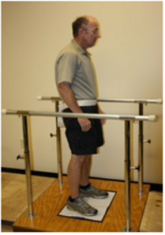
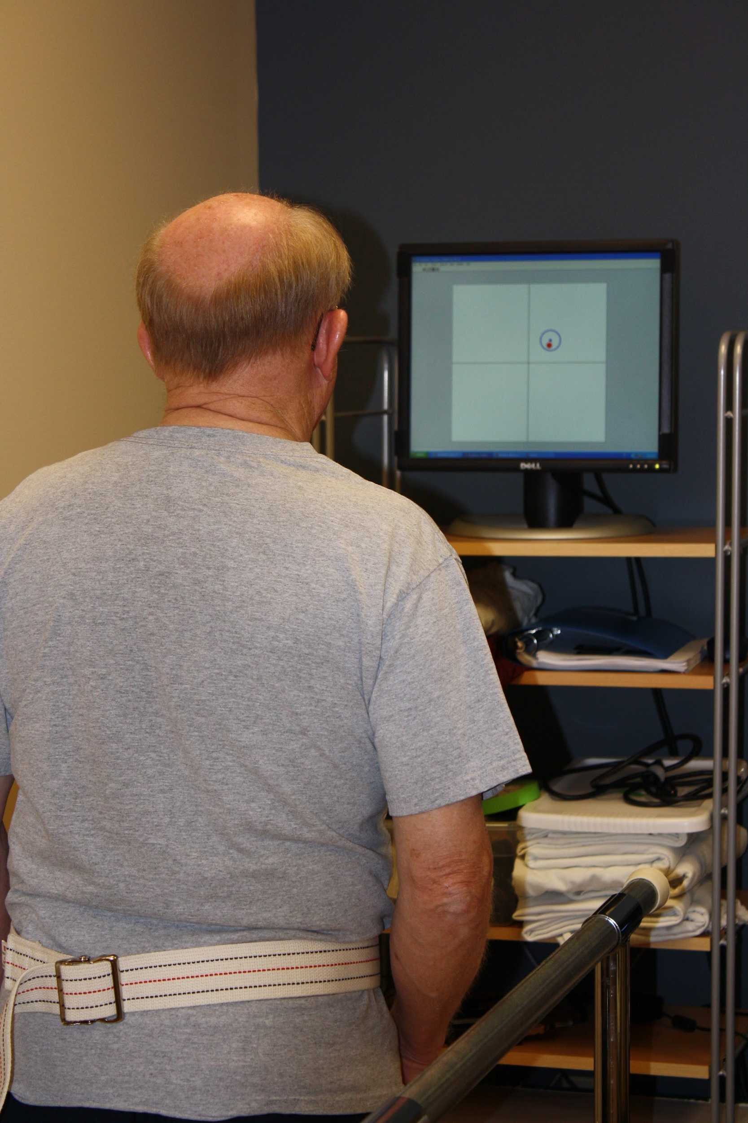
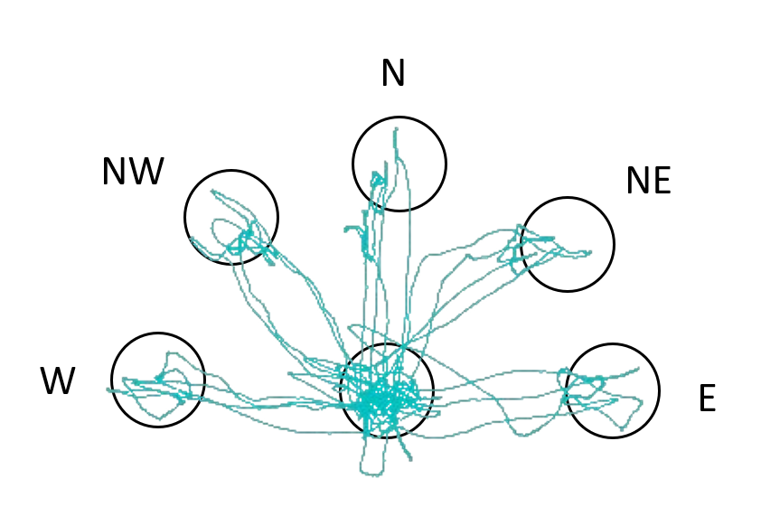
Data Collection
Screen
Pressure Plate Platform
Figure 1: Patient Standing on Pressure Plate Platform
Figure 2: Patient View of screen marking targets and COP
Figure 3: Visualization of COP movement during target reaches
[1] A. Som, N. Krishnamurthi, V. Venkataraman, and P. Turaga. Attractor-shape descriptors for balance impairment assessment in parkinson’s disease. In 2016 38th Annual International Conference of the IEEE Engineering in Medicine and Biology Society (EMBC), pages 3096–3100. IEEE, 2016.
[2] N. Krishnamurthi, S. Mulligan, P. Mahant, J. Samanta, and J. J. Abbas. Deep brain stimulation amplitude alters posture shift velocity in parkinson’s disease. Cognitive neurodynamics, 6(4):325–332, 2012.

Slide 6
Dataset Composition
Healthy Subjects
Parkinson’s Subjects
Elderly Subjects
22 Subjects
5 Trials Each
Parkinson’s Disease Subjects
17 subjects
3 Trials Each
Young Subjects
21 subjects
5 Trials Each
60 Subjects 266 Trials

Slide 7
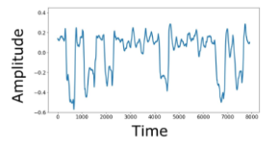
Data Representation
X : measurement in the medio-lateral direction
Y: measurement in the antero-posterior direction
F_{x}, F_{y}, F_{z} : Forces and in the X, Y, Z direction
M_{x}, M_{y}, M_{z} : Moments in the X, Y, Z direction
Each signal consists of the value in the chosen direction with respect to time.

Slide 8
Methods
Notes:
-rephrase methods stuff

Slide 9
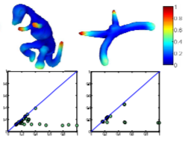
Topological Data Analysis
Analyze Structure and Shape of Data
Time Series, Point Clouds, Images
Why Topological Data Analysis?
Invariant to order of target reaches
Invariant to smooth deformations (stretching, bending, scaling, etc)
[3] C. Epstein, G. Carlsson, and H. Edelsbrunner. Topological data analysis. Inverse Problems, 27(12):120201, 2011
[4] G. Carlsson. Topology and data. Bulletin of the American Mathematical Society, 46(2):255–308, 2009.
[5] C. Li, M. Ovsjanikov, and F. Chazal. Persistence-based structural recognition. In Proceedings of the IEEE Conference on Computer Vision and Pattern Recognition, pages 1995–2002, 2014
Notes:
Cite papers

Slide 10
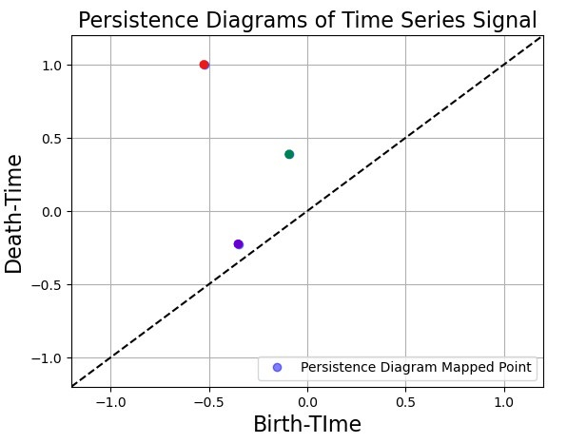
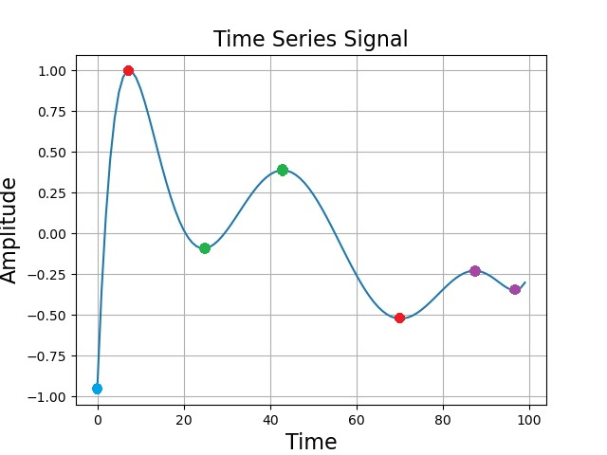
Topological Data Analysis
Mapping of time-series data as a pairing of its peaks with its troughs.
Represents information about the smoothness of the data, as well as its rises and falls

Slide 11
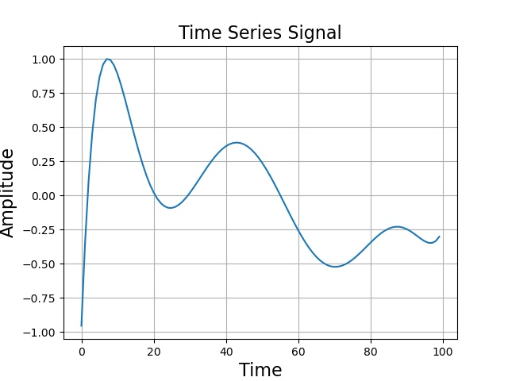
Topological Data Analysis
Time-series signal can be modeled as a graph with multiple nodes, each connected to two neighbors (except the ends)
Each node’s value is its y-value on the plot

Slide 12
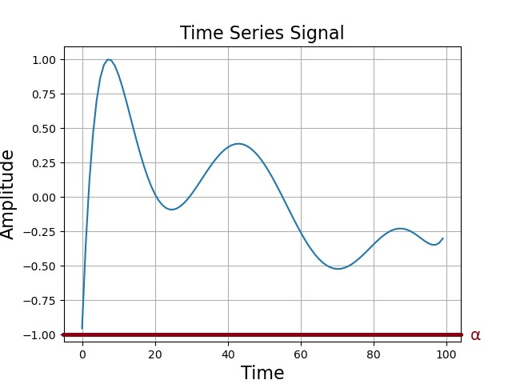
Topological Data Analysis
Alpha value is swept from -∞ to ∞, identifying troughs and matching them to peaks as it increases.
Local minimum (trough) is any node whose value is less than those of all of its neighbors.

Slide 13
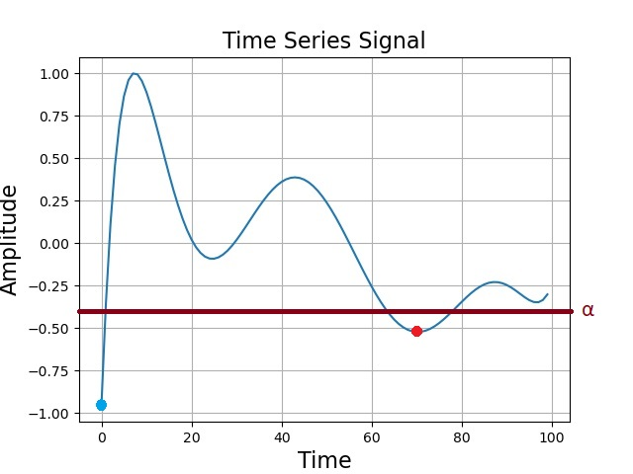
Topological Data Analysis
When alpha is swept passed a node that it identifies as a local minimum, it saves the value of that node as the birth of that trough
Blue trough is born at about -0.95
Red trough is born at about -0.5
Birth-time:
Value (Y-axis) of local minimum.

Slide 14
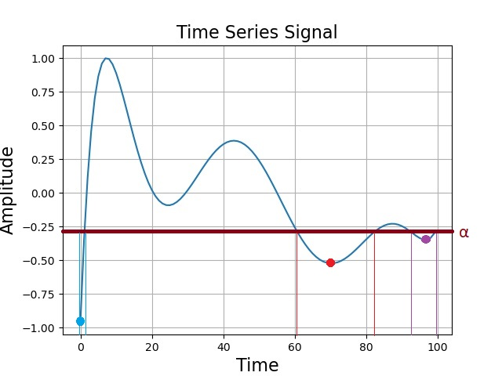
Topological Data Analysis
Purple trough born at about -0.3
Algorithm keeps track of the subgraphs of the overall graph for values below alpha
Alpha value splits graph into several explored subgraphs, boundaries show the minimum for each subgraph

Slide 15
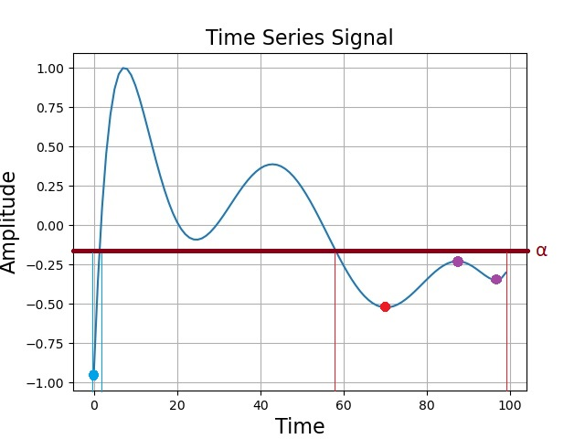
Topological Data Analysis
The death of a trough is given by the lowest alpha value such that the trough is no longer the minimum of its subgraph.
Red trough is now the minimum of the right subgraph.
Purple trough dies at about -0.25
Death-time:
Value (Y-axis) of matched peak.

Slide 16
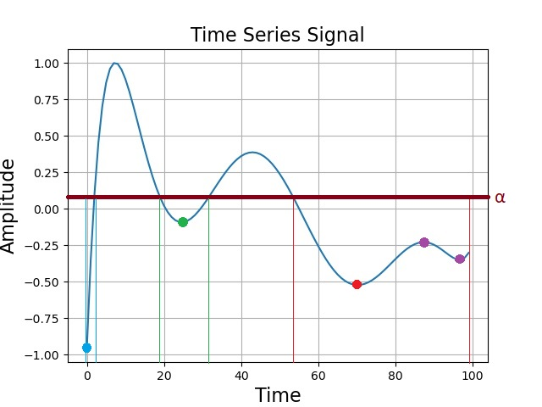
Topological Data Analysis
Green trough is born at about -0.1

Slide 17
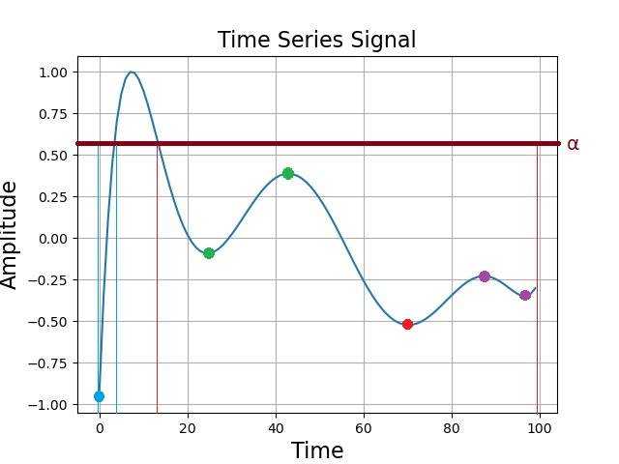
Topological Data Analysis
Green trough dies at about 0.35
Red trough is now the minimum of right-most subgraph.

Slide 18
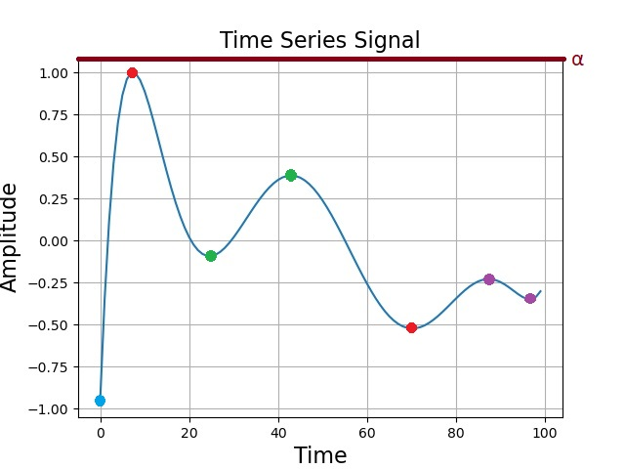
Topological Data Analysis
Red trough dies at about 1.
The algorithm terminates when all node values are smaller than alpha.
As the global minimum (blue trough) does not die, it is given a death time of infinity.

Slide 19
Persistence Diagrams
Lifetime = Death-time - Birth-time
[4] G. Carlsson. Topology and data. Bulletin of the American Mathematical Society, 46(2):255–308, 2009.
Notes:
Persistence diagram only exists in top half

Slide 20
Persistence Diagrams
Pros:
Good way to uniformly represent variable length time-series data.
One of the most commonly used topological descriptors
Cons:
Not easily used in standard machine learning algorithms, as the number of points that we observe on a persistence diagram varies from sample to sample
Notes:
Since the persistence diagram is a multiset of points

Slide 21
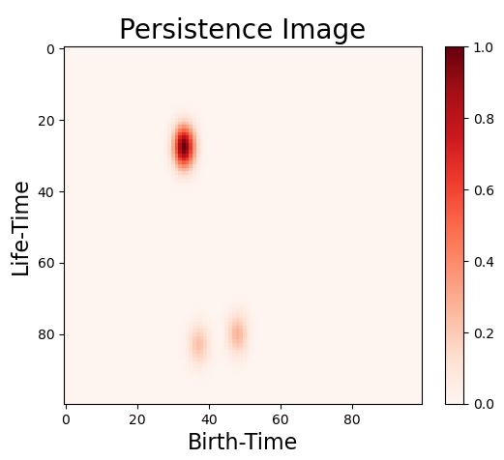
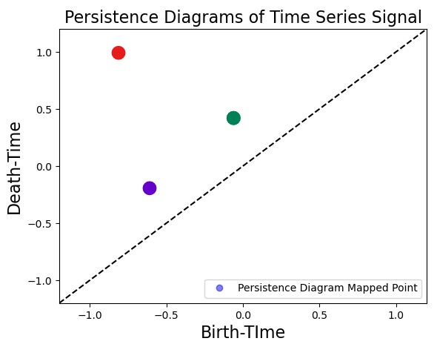
Persistence Images
[6] H. Adams, T. Emerson, M. Kirby, R. Neville, C. Peterson, P. Shipman, S. Chepushtanova, E. Hanson, F. Motta, and L. Ziegelmeier. Persistence images: A stable vector representation of persistent homology.
The Journal of Machine Learning Research, 18(1):218–252, 2017.

Slide 22
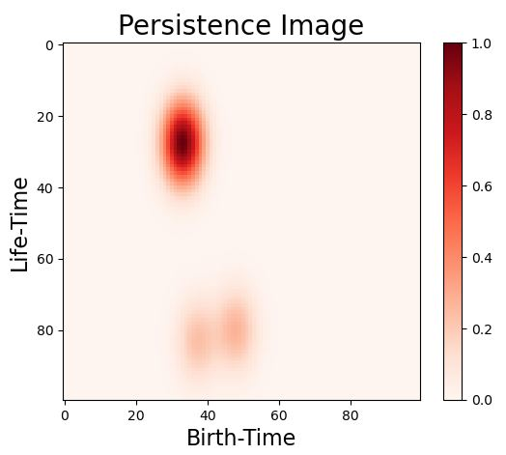
Effect of Spread
Spread = 0.1
Spread = 0.2

Slide 23
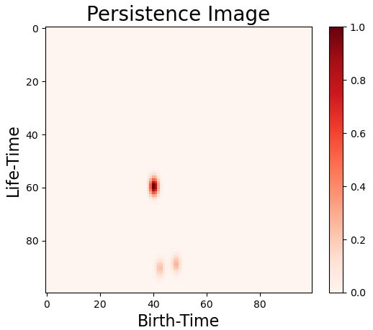
Effect of Range
Range = [-2.5, 2.5]
Range = [-4.5, 4.5]

Slide 24
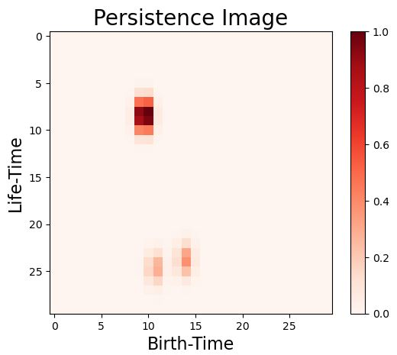
Effect of Pixel Value
Pixel Grid: 100x100
Pixel Grid: 30x30

Slide 25
Application

Slide 26
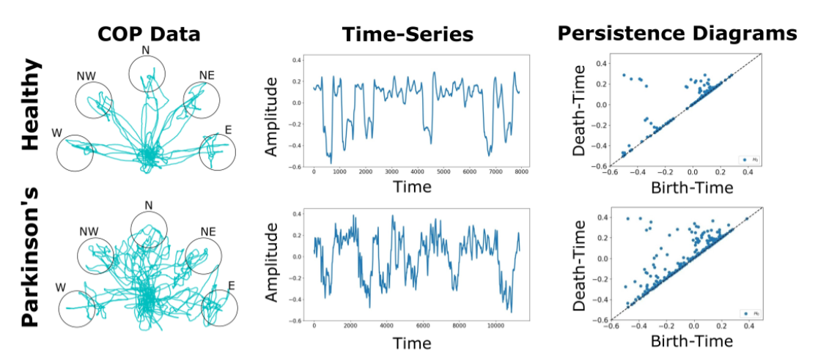
Processing Flow
Round-Robin Leave-One-Subject-Out Cross Validation Protocol with Support Vector Machines
Binary Classification
Parkinsons vs. Healthy
Three-Class Classification
Parkinsons vs. Young vs. Elderly
Regression
Parkinsons Patients Given Clinically Assigned UPDRS Scores
Healthy Patients Given UPDRS Score of 0
Notes:
Mention it is COP data, list bullet point protocol (cross validation test)

Slide 27
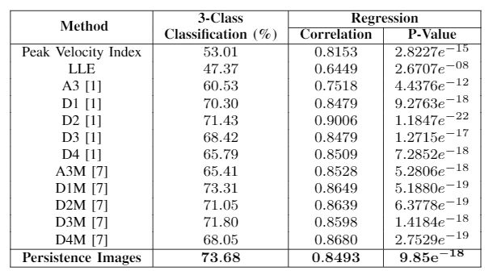
Experimental Results
Binary Classification:
98.87%
[1] A. Som, N. Krishnamurthi, V. Venkataraman, and P. Turaga. Attractor shape descriptors for balance impairment assessment in parkinson’s
disease. In 2016 38th Annual International Conference of the IEEE Engineering in Medicine and Biology Society (EMBC), pages 3096–3100. IEEE, 2016
[7] A. Som, N. Krishnamurthi, V. Venkataraman, K. N. Ramamurthy, and P. Turaga. Multiscale evolution of attractor-shape descriptors for assessing parkinson’s disease severity. In 2017 IEEE Global Conference on Signal and Information Processing (GlobalSIP), pages 938–942. IEEE, 2017.

Slide 28

Thank You
For any questions, please do not hesitate to email us at:
Afra Nawar: anawar@asu.edu
Farhan Rahman: fnrahman@asu.edu
Anirudh Som: asom2@asu.edu
Also refer to our GitHub repository with sample code here: https://github.com/itsmeafra/Sublevel-Set-TDA

